Slide 1
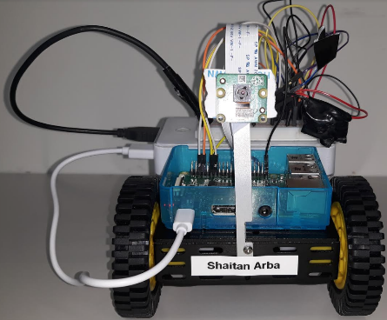

Alternative Human-Computer Interfaces
Pavel Sobolev
2019

Slide 2
Executive summary
Aim of the project
Design,
Development,
And Implementation
of hardware and software system
which delivers oculomotor and brain interfaces between a user and a robotic system

Slide 3
Executive summary
The original idea
is to control the robot's movements using an oculomotor interface and a brain-computer interface.
this system can be a prototype for a professional system that can provide handicapped people with the ability to control the movement of a motorized transport devices using
eyes movements detection
and monitoring of a user’s brain activity.

Slide 4
Plan of the project
Design and implementation of hardware architecture:
The robot’s components
Oculomotor hardware component
Brain-computer interface component
Learning and choosing of possible suitable SDLC
Learning, choosing and implementation of a suitable architecture for the robotic software system
Learning and choosing of software components (operating systems, servers, etc.) for the robot-side and user-side parts of the system
Learning and choosing of suitable software technologies for implementation of the robot-side and the user-side components of the system
Undertaking activities to achieve quality characteristics

Slide 5
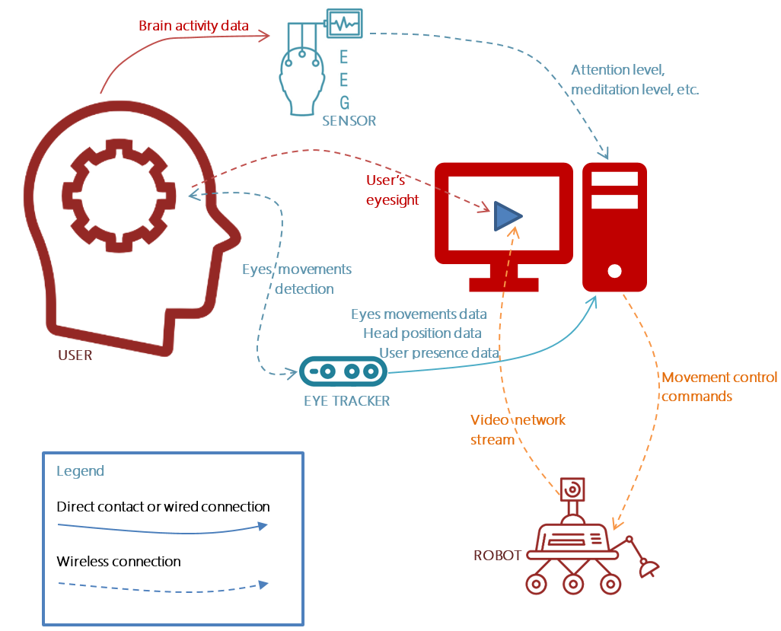
Overall system architecture

Slide 6
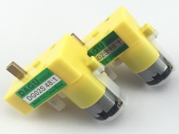
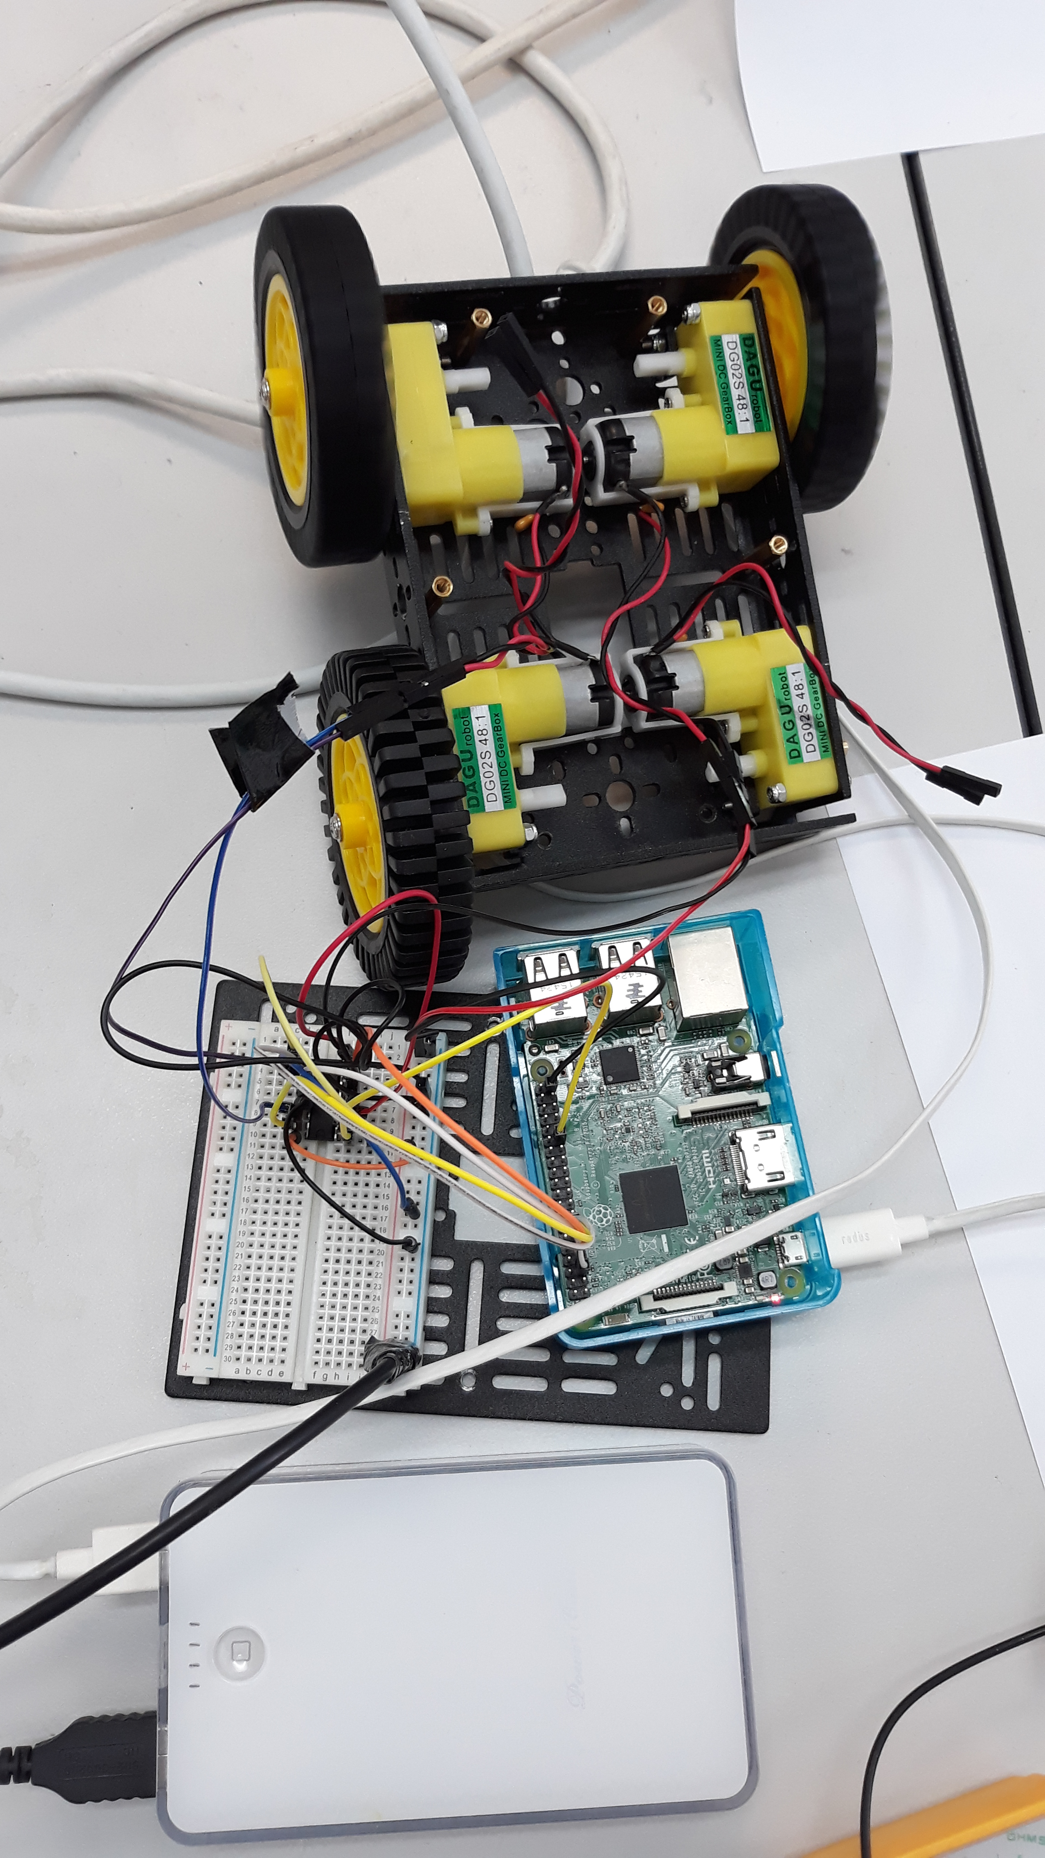
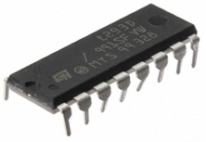
Hardware (robot)
DC motors
with wheels
L293D
Motor driving
integrated circuit
Breadboard
Raspberry PI
Video camera
GPIO pins

Slide 7
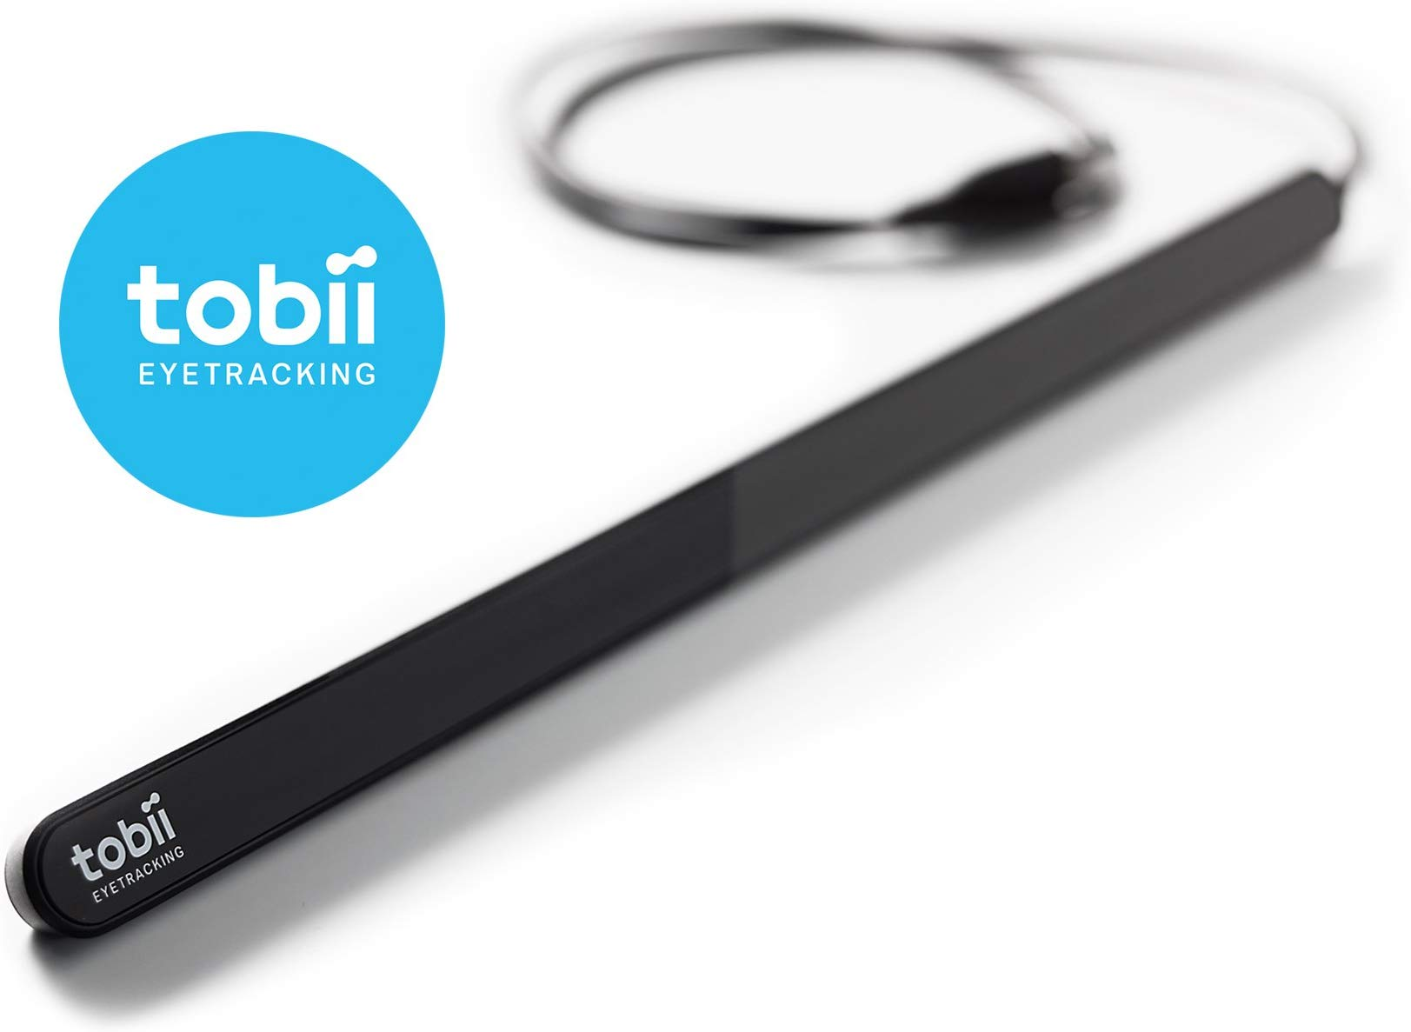
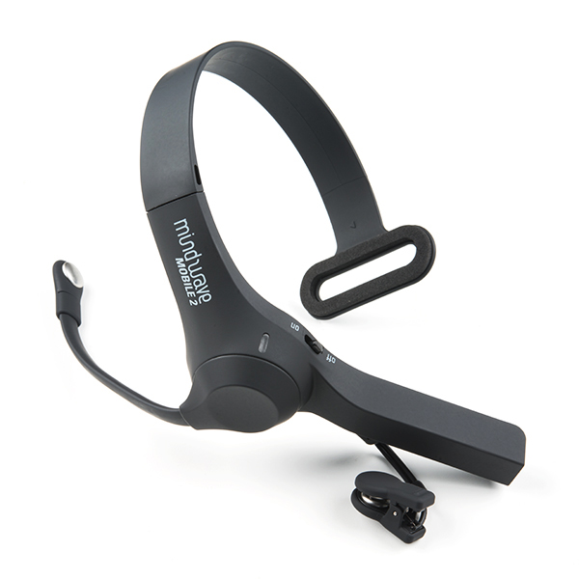
Hardware (desktop)
Tobii Eye Tracker 4C
NeuroSky MindWave Mobile 2 Headset

Slide 8
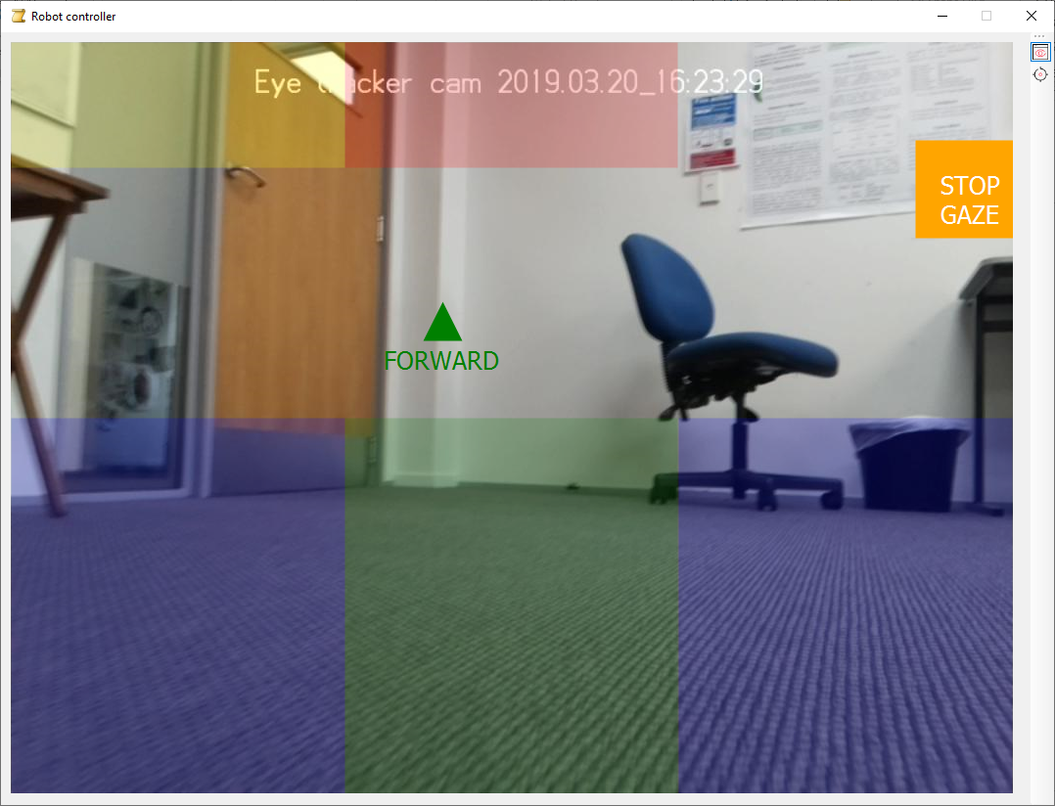

Slide 9
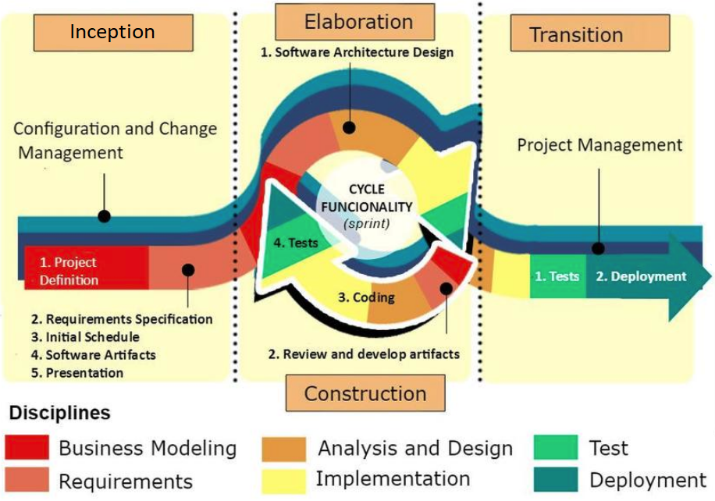
Software Development Life Cycle
Incremental Iterative
Used implementation of SDLC:
Object-oriented
methodology
within
IBM Rational Unified Process

Slide 10
Use case diagram

Slide 11
System architecture
Three-layered architecture for robotic software
(Ahmad & Ali Babar, 2016; Gomaa, 2000; Kortenkamp, 2015)
Planner layer (abstract representation)
Executive layer (intermediate representation)
Functional layer (low level representation)
Creation of tasks for executive layer
Creation of behavior for implementation of received task
Behavioural control of the system
Forming of commands for functional layer
Execution of commands by interaction with sensors, actuators, motors, etc.

Slide 12
Mapping of software components to used architecture
Layers | Components and their classes
Planner layer Forming of high-level motion commands (without any assumptions about possible low-level implementation), sending of commands to the executive layer | SettingsStorage (DLL) [SettingsData, InternalStorageProvider] GazeSurface (DLL) [GazeSurface] Enumerations (DLL) [EnumStrings, MoveGoalRectangle] CommandSsh (DLL) [SshConnector] CommandMotion (DLL) [IMotionCommand, GPIOSshMotion] ClassesExtentions (DLL) [PointExtention, NewtonJsonReaderExtention, StringToRobotCommandExtention] GazeMindDriver (EXE) [MainWindow]
Executive layer Forming of the equipment-oriented commands, interaction with the robot | StreamVideo (DLL) [MotionDirectionChangedArgs, GazeCommanderPictureBox] StreamGaze (DLL) [IGazeStream, TobiiGazeStream] StreamMind (DLL) [BrainActivityValues, BrainWaveEventArgs, MindStream] ConnectorHttp (DLL) [ConnectionStatusEventArgs, HttpConnector] CommandGPIO (DLL) [GPIOCommand, GPIOWheelPort]
Functional layer Physical execution of the commands, providing of video stream | SSH (executive built-in system component), GPIO (executive built-in system component) CAM_PIC.PHP

Slide 13
System architecture
Three-layered architecture for robotic software
(Ahmad & Ali Babar, 2016; Gomaa, 2000; Kortenkamp, 2015)
This architecture allowed to achieve
Good level of abstraction from concrete hardware
High level of decoupling of components of each level
Cohesion between components of the same level
This approach restricts way of interaction between levels (best practices are event-bus architectural pattern or pipeline architectural pattern)
Disadvantages
Possible high level of granularity which makes system complicated for understanding and can affect maintainability

Slide 14
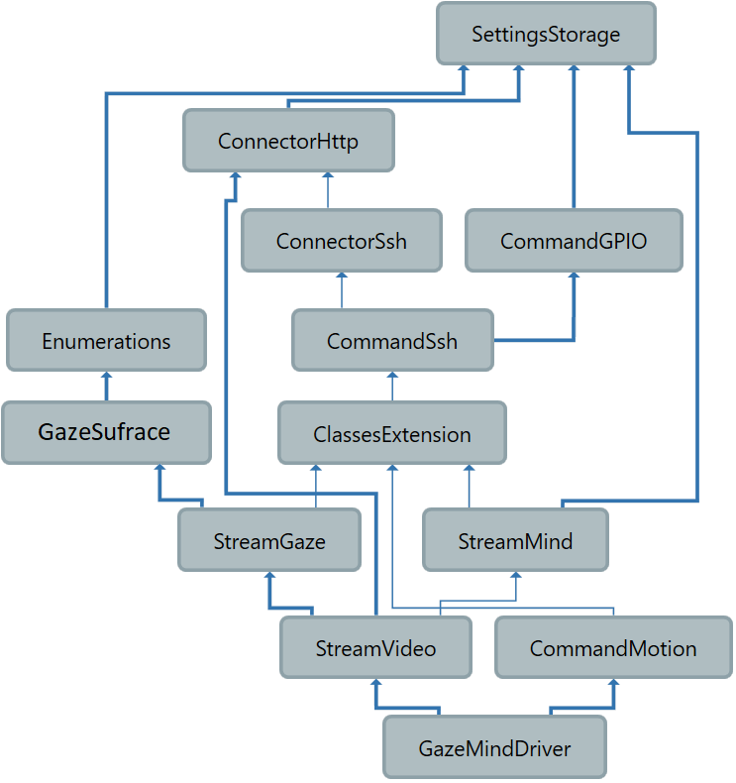
Modules dependencies diagram

Slide 15
Class diagram

Slide 16



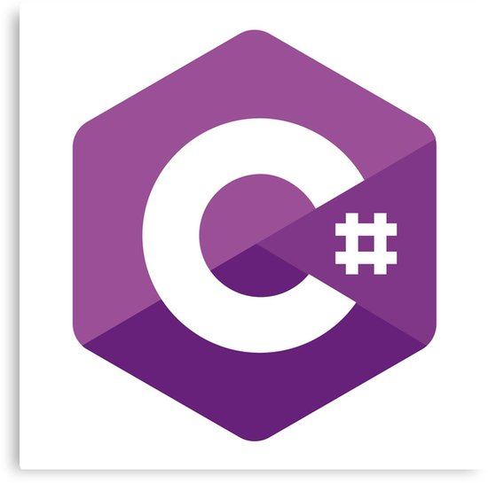








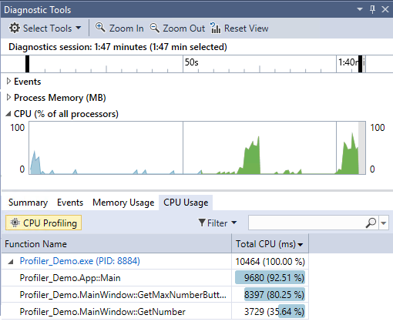









Technologies
System level
Languages
SDLC
Testing and QA
Development tools, APIs, SDKs, platforms
SDK
VS PROFILER
Data: storage/exchange/protocols
SDK

Slide 17
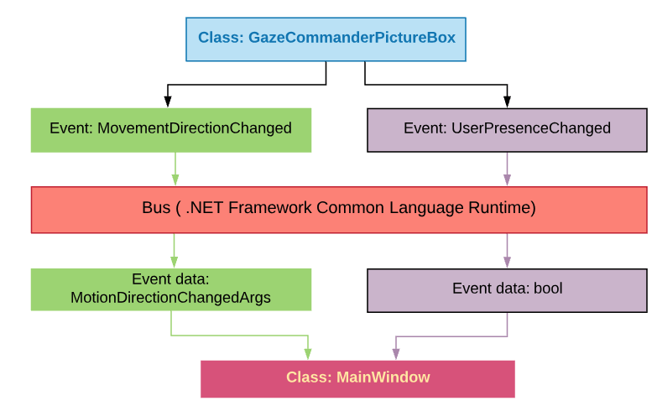
Architectural patterns • Event bus

Slide 18
Performance problems
Initial implementation showed decaying of performance (hangings, unresponsive UI, significant video latency)
Cause of the problem
Large amount of data streaming to the app from:
Eye tracking hardware
EEG Headset
Video camera of the robot
Necessity to receive and send data and commands over relatively slow network channels (awaiting causes unresponsiveness).
Solution of the problem
Performance testing and profiling
Introducing and implementation of multithreading architecture.

Slide 19
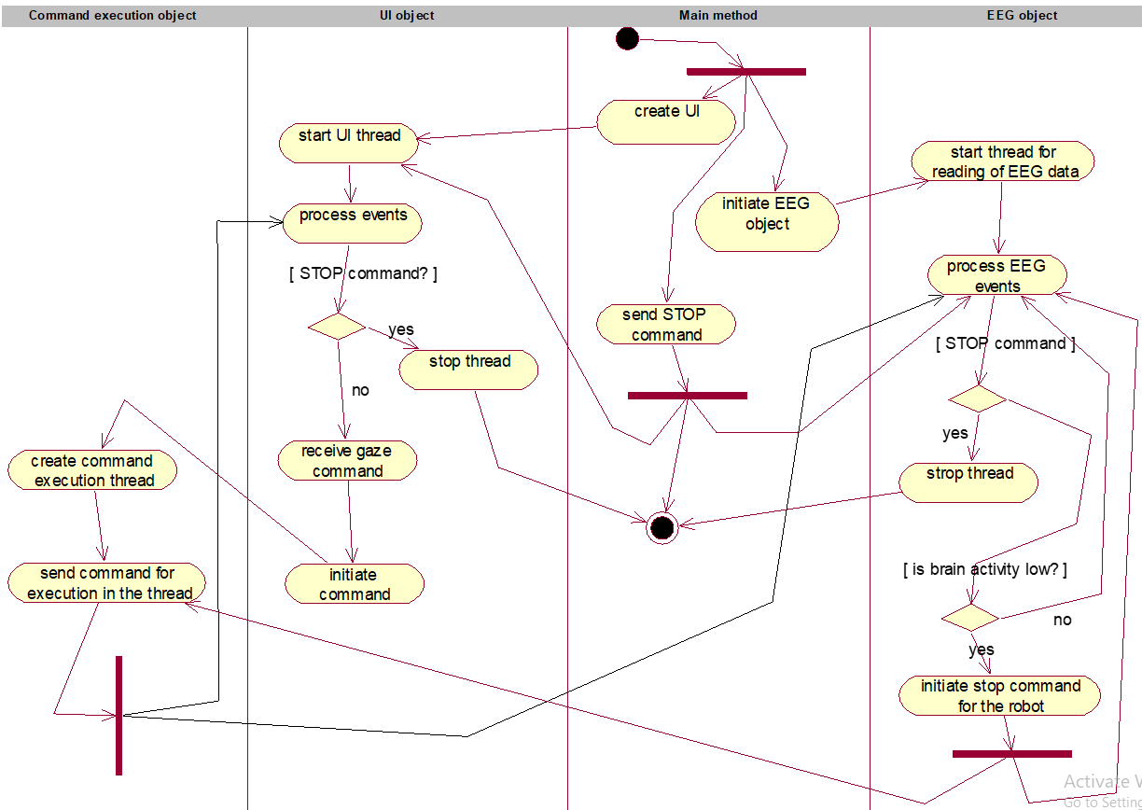
Usage of multithreading
Command thread
UI tread
Main thread
EEG tread
.NET thread pool .NET tasks

Slide 20
QA and testing
I tried to implement the beast practices of software engineering (SOLID principles, creation of loosely coupled components and cohesive modules)
I tried to keep using of test driven development approach
I used xUnit to impellent unit testing
I used profiling tools to measure the performance and find issues with resources consumption
I used JetBrains ReSharper to evaluate source quality code
I used functional testing to meet the requirements
I used performance testing to improve system efficiency
I asked groupmates to use the system to understand acceptance level

Slide 21
Reflection
New ideas/experience/skills/technologies
Implementation of iterative incremental SDLC
Usage of UML and Rational Unified Process framework of SDLC
Learning and realization of architecture of robotic software systems
Design and assembly of the robot with valuable support from Ganeshan!
Learning and implementation of gaze input and EEG-input
Searching of solutions for problems with the system performance (performance testing, profiling, implementation of multithreading and inter-process interaction)
Usage of new low-level software and protocols: GPIO and SSH.
Combining of multiple non-homogenous technologies within one project

Slide 22
Reflection
Possible enhancements and improvements of the project
Hardware part
usage of more sophisticated moveable part (with feedback)
usage of additional sensors (for avoiding collisions with objects)
usage of more advanced video camera
Software part
software can be made more universal (in the sense of possible client side) by utilization of microservice architecture
there is a need to implement smoother video rendering
It would be useful to learn about patterns of brain activity of a car driver (during the process of driving) because this can make controlling of the robot more reliable
it would be useful add ability to edit settings for hardware part and the app’s characteristics

Slide 23
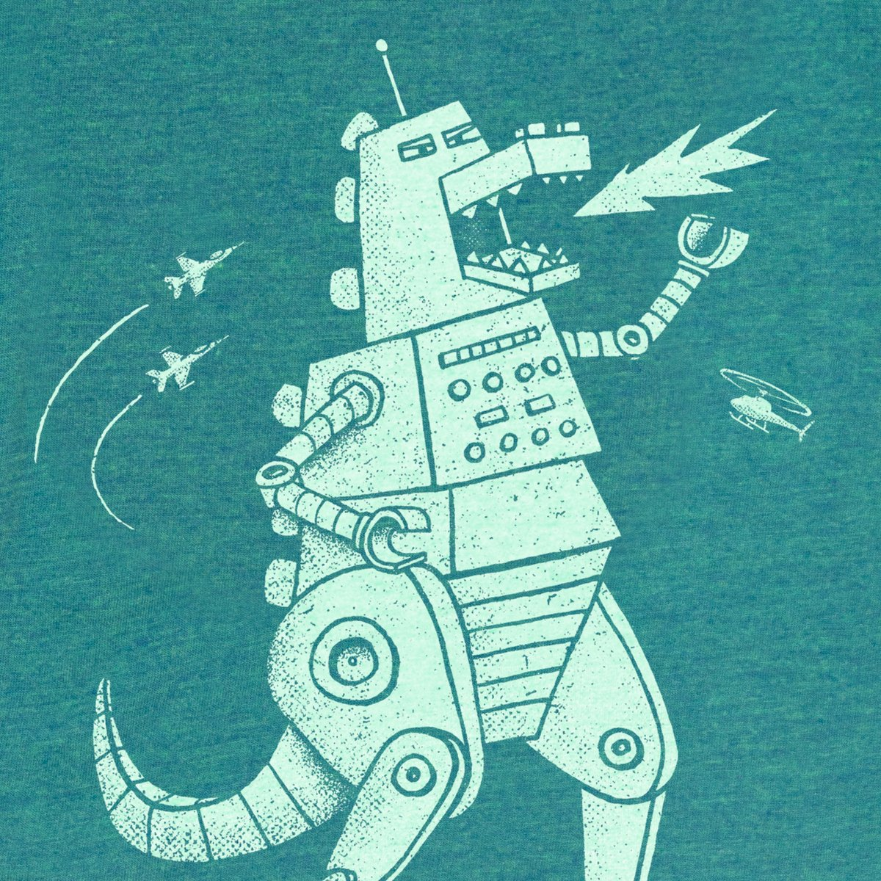
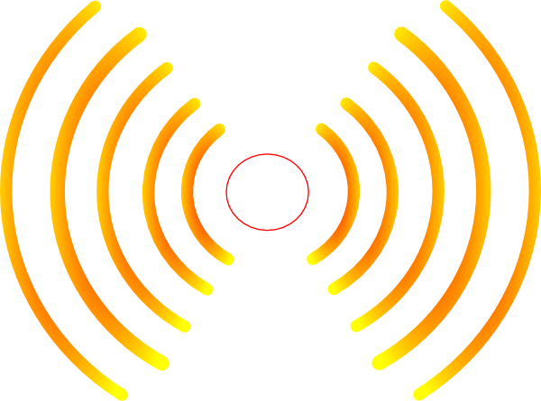



THANK YOU!

